Slide 1
A Hybrid CNN + Residual GCN
for Blood-Cell Image Classification
on BloodMNIST
CSE475: Machine Learning | Group04

Slide 2
Project Information
Submitted To
Dr Raihan Ul Islam
Associate Professor
Department of CSE
East West University
Submitted By
Nishat Subha Mithela — 2023-1-60-248
Nusrat Jahan — 2022-2-60-128
Humayara Nahar Moumita — 2021-2-60-121
Fahmida Jannat — 2025-1-60-334

Slide 3
Introduction
Item | Scope
Dataset | BloodMNIST
Classes | 8
Main model | ResNet50 + Residual GCN
Final focus | Accuracy + macro-F1 + XAI
Project Background
› BloodMNIST is a small biomedical image dataset of blood-cell microscopy images.
› The task is to classify each image into one of eight blood-cell types.
› Many classes look similar, so the model must learn fine local cell details.
› Our project tests whether graph reasoning can improve a strong CNN baseline.
Task 1
EDA + data quality
Task 2
Baseline+ Proposed Model+ GCN
Task 3
Final GCN + XAI

Slide 4
Motivation and Research Gap
Approach | Limitation
CNN | Local features only
Attention | Focuses regions, but no graph reasoning
Transformer | Strong, but heavier
CNN + GCN | Can model region relationships
Why this is hard
› Blood-cell classes can look very similar in tiny microscopy images.
› Global CNN features may hide small but useful cell-region details.
› The dataset is moderately imbalanced, so macro-F1 matters with accuracy.
The project tests whether graph reasoning adds useful spatial context.

Slide 5
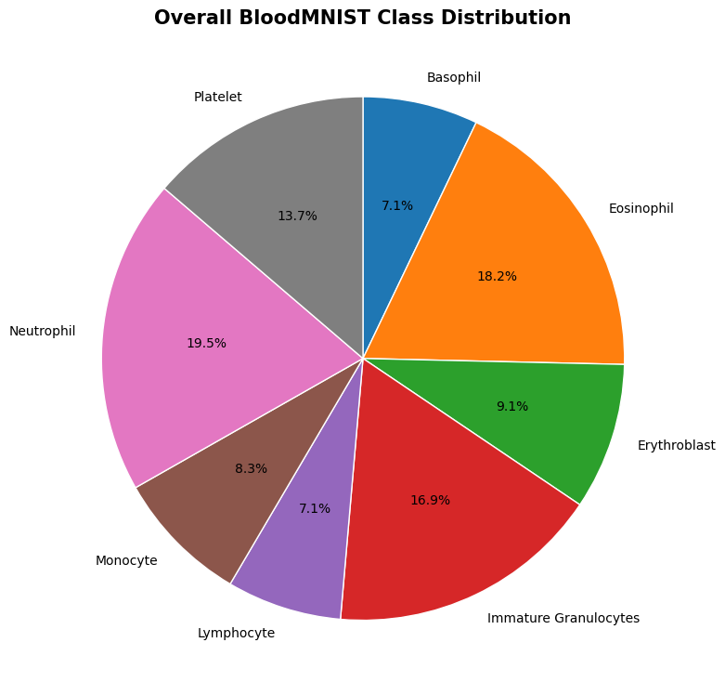
Dataset and EDA Findings
Item | Finding
Total images | 17,092
Train / Val / Test | 11,959 / 1,712 / 3,421
Image format | 28×28 RGB
Classes | 8 blood-cell categories
Quality audit | No missing/blank/invalid images
› Clean data, but class imbalance means macro-F1 should be reported.

Slide 6
Preprocessing and Experiment Setup
Official splits
kept unchanged
Resize
224×224×3
Balance train
undersampling + weights
Train
Adam + early stop
Evaluate
held-out test
Setting | Value
Batch size | 32
Optimizer | Adam
LR | 0.001
Seed | 42
Outcomes
› No new random test split was made.
› Balancing was applied only on training data.
› This keeps the final test comparison fair.

Slide 7
Baseline CNN Results
Model | Accuracy | Macro-F1
DenseNet121 | 82.87% | 78.19%
ResNet50 | 90.56% | 89.50%
EfficientNetB0 | 88.92% | 87.97%
MobileNetV3Large | 91.26% | 90.38%
Outcomes
› MobileNetV3Large became the strongest CNN baseline.
› BloodNet CNN+Attention scored 73.14%, so attention alone was not enough.
› The final model must improve both accuracy and macro-F1.

Slide 8
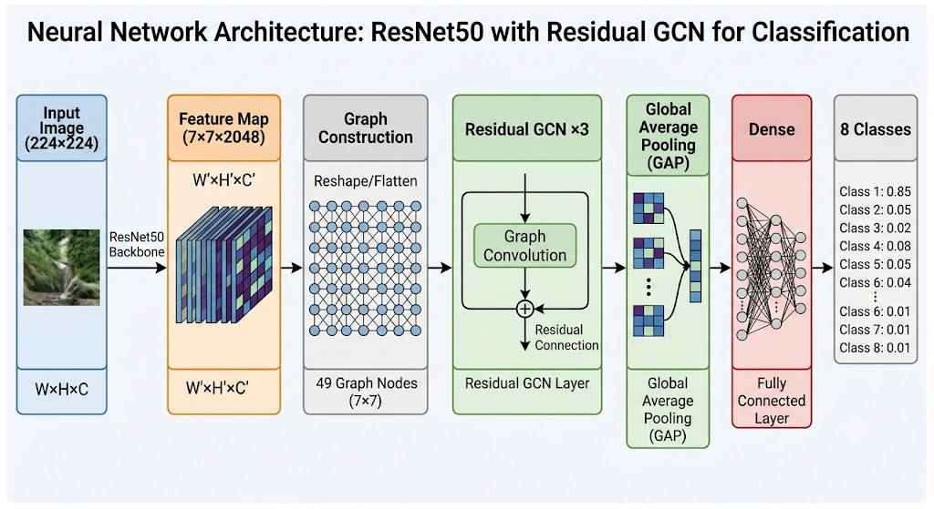
Proposed Model Architecture
In simple words
› ResNet50 extracts a 7×7×2048 feature map.
› Each spatial location becomes one graph node.
› Residual GCN passes information between nearby regions.
› Global pooling turns graph features into one prediction.

Slide 9
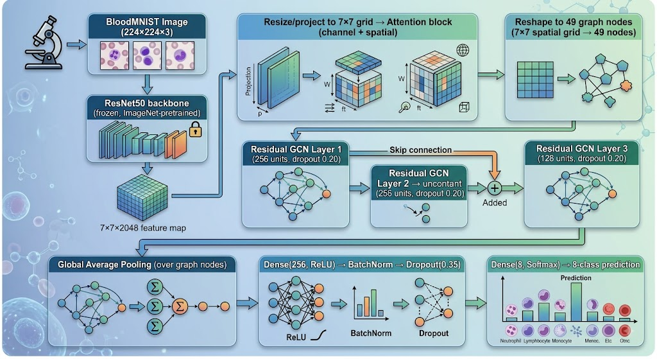
Proposed Architecture Diagram

Slide 10
How the Graph Part Helps
1
2
3
8-class output
Basophil, Eosinophil, ... Platelet
Residual GCN ×3
neighbor messages + skip connection
49 graph nodes
from 7×7 feature map
› Neighboring regions can share information before classification.
› This is useful when class differences are small and local.
› Skip connections reduce information loss across graph layers.

Slide 11
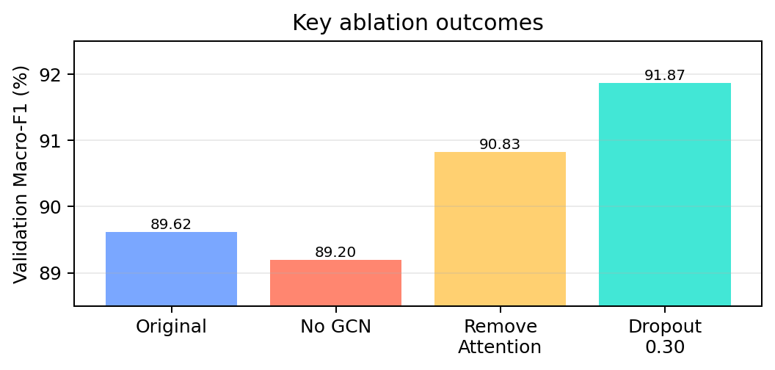
Ablation Study
Experiment | Change | Macro-F1
A0 | Remove GCN | 89.20%
A1 | Remove attention | 90.83%
Dropout 0.30 | Final selected | 91.87%
GraphSAGE | Change GNN | 90.52%
› Graph reasoning helped, but the attention block was not needed in the final pipeline.

Slide 12
Final Configuration
Component | Final choice
Backbone | Frozen ImageNet ResNet50
Input | 224×224×3
Feature map | 7×7×2048
Graph | 49 nodes, four-neighbor, self-loops
GNN | Residual GCN, 3 layers
Hidden dims | 256 → 256 → 128
Dropout | GCN 0.30, classifier 0.35
92.64%
Validation accuracy
91.87%
Validation macro-F1
99.41%
Validation macro-AUC

Slide 13
Final Test Results
91.82%
Accuracy
91.74%
Macro precision
90.87%
Macro recall
91.18%
Macro-F1
99.33%
Macro ROC-AUC
Metric | Value
Weighted-F1 | 91.90%
Cohen’s Kappa | 0.9043
MCC | 0.9049
Inference/image | 5.186 ms
Outcomes
› The final model was evaluated after the architecture was locked.
› Results are from the untouched BloodMNIST test set.
› Macro-F1 confirms balanced performance across classes.

Slide 14
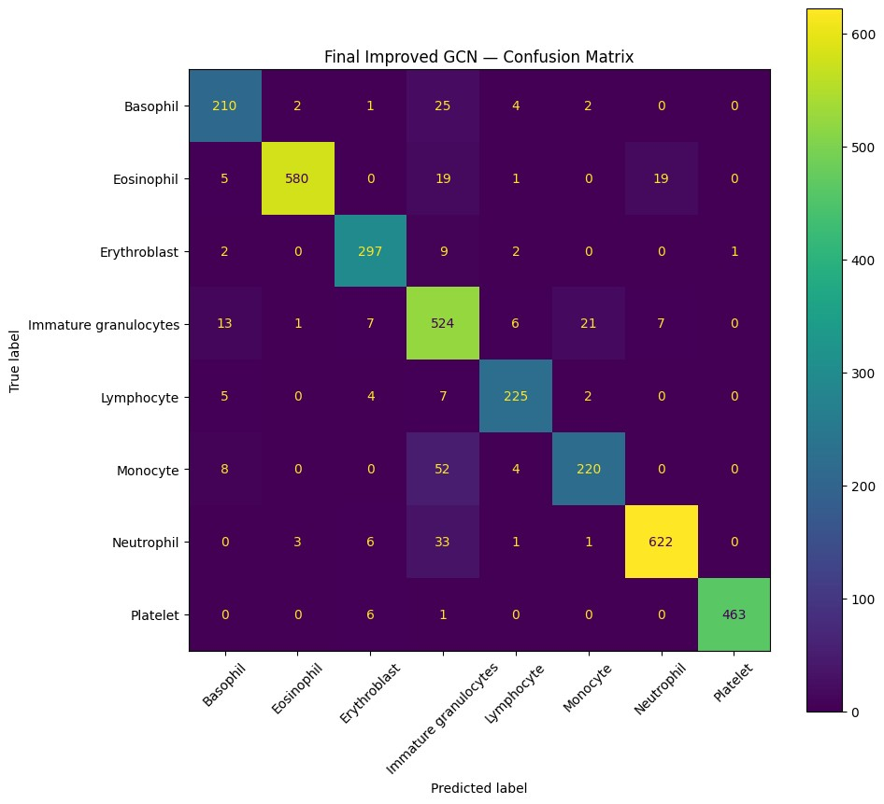
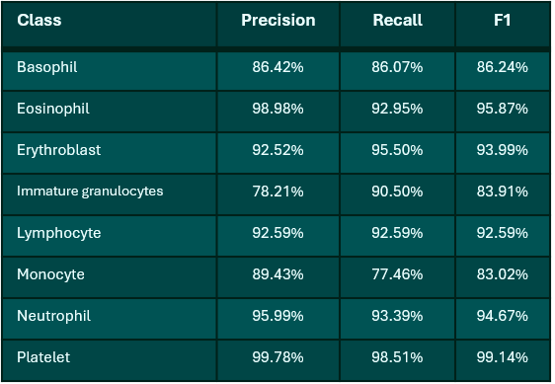
Class-Level Performance
› Most errors concentrate around visually similar granulocyte/monocyte regions.

Slide 15
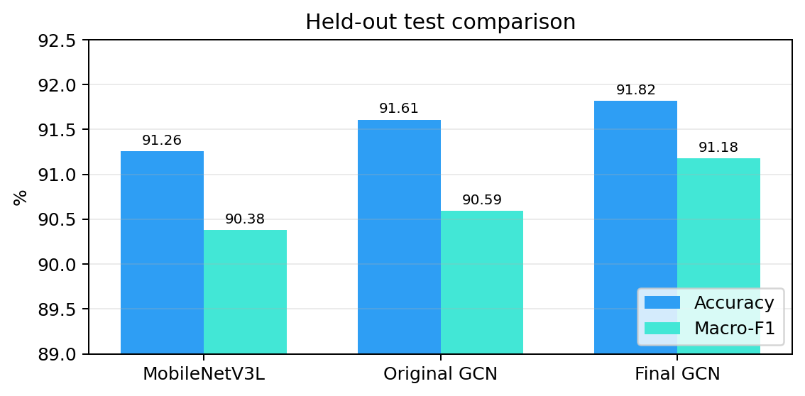
Comparison with the Best CNN Baseline
Model | Acc. | F1
MobileNetV3Large | 91.26% | 90.38%
Original GCN | 91.61% | 90.59%
Final GCN | 91.82% | 91.18%
Outcomes
› +0.56 pp accuracy over Task 2 MobileNetV3Large.
› +0.80 pp macro-F1 over Task 2 MobileNetV3Large.
› The gain is modest but consistent across key metrics.

Slide 16
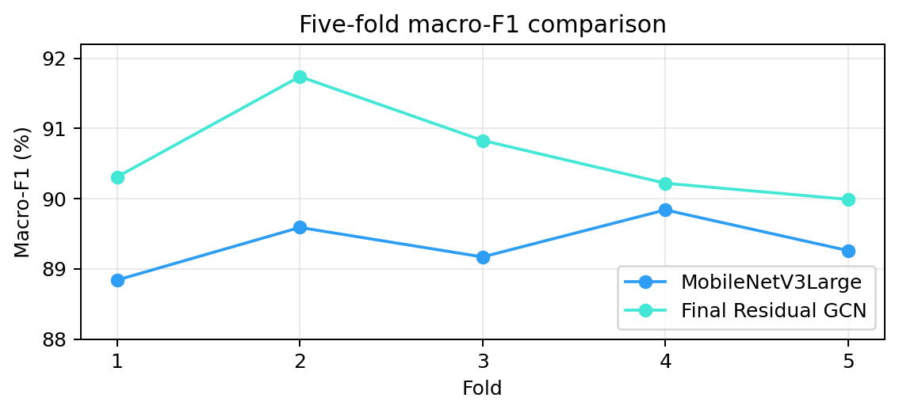
Cross-Validation and Statistical Tests
Test | Value | Decision
CV macro-F1 gain | +1.28 pp | Final GCN higher in all folds
McNemar p | 0.201397 | Not significant
Wilcoxon p | 0.062500 | Not significant
Outcomes
› The improvement is stable across folds.
› But the statistical tests did not pass α = 0.05.
› Best wording: consistent and promising, not statistically proven.

Slide 17
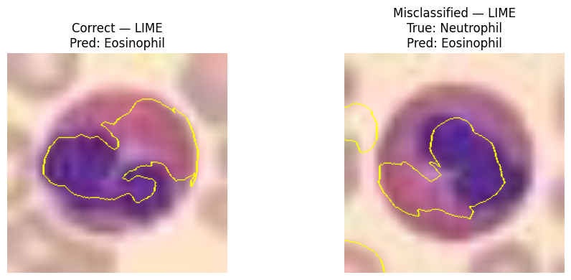
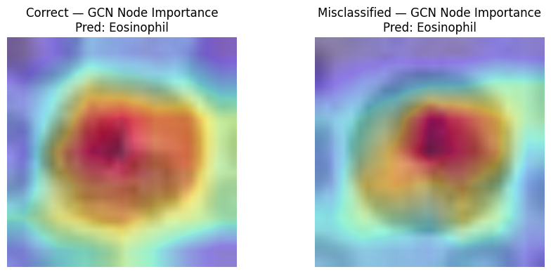
Explainability
Outcomes
› Grad-CAM: highlights CNN feature-map regions.
› LIME: shows local image regions that affect prediction.
› GCN node importance: explains the 49 graph nodes directly.
› The report compares one correct Eosinophil prediction and one Neutrophil → Eosinophil error.
› Interpretation: the methods are complementary, not a biological proof by themselves.

Slide 18
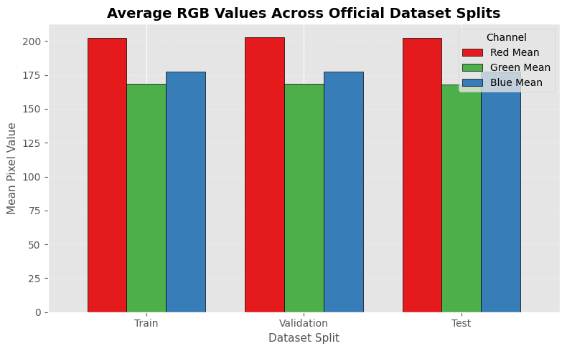
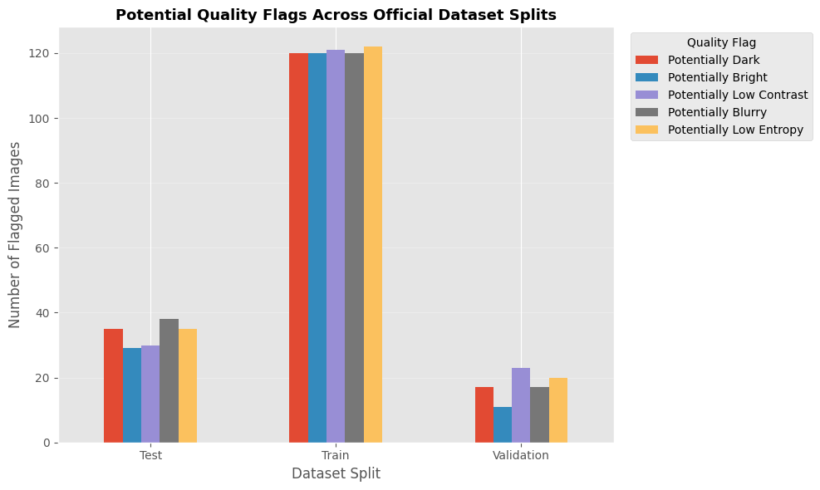
Additional EDA Visuals
RGB distribution across splits
Potential quality flags

Slide 19
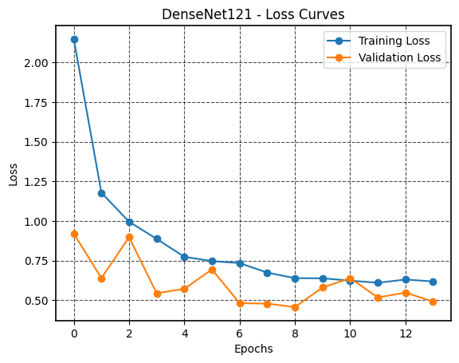
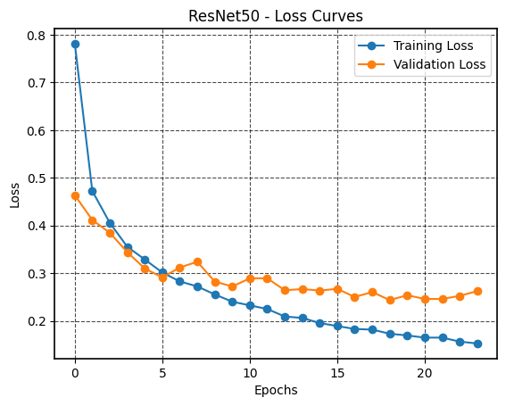
Baseline Loss Curves I
DenseNet121
ResNet50

Slide 20
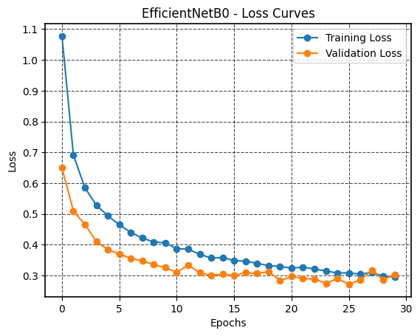
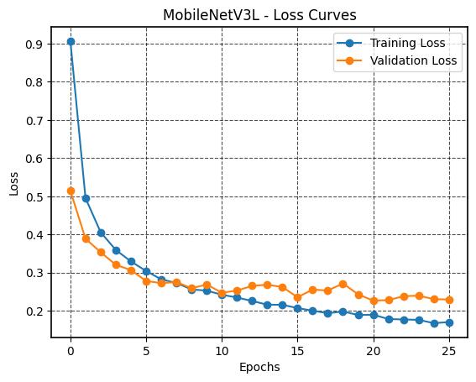
Baseline Loss Curves II
EfficientNetB0
MobileNetV3Large

Slide 21
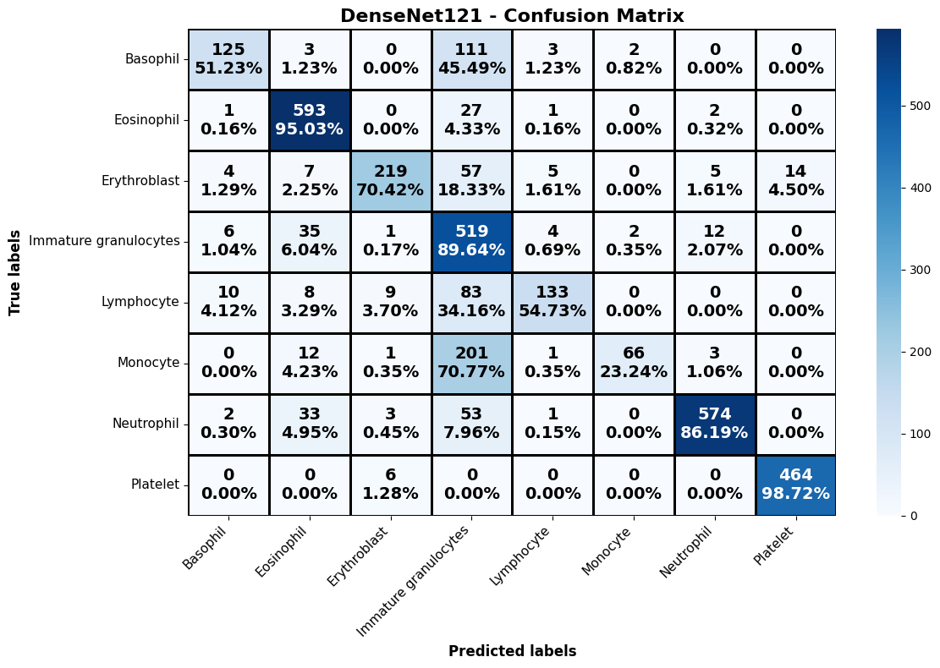
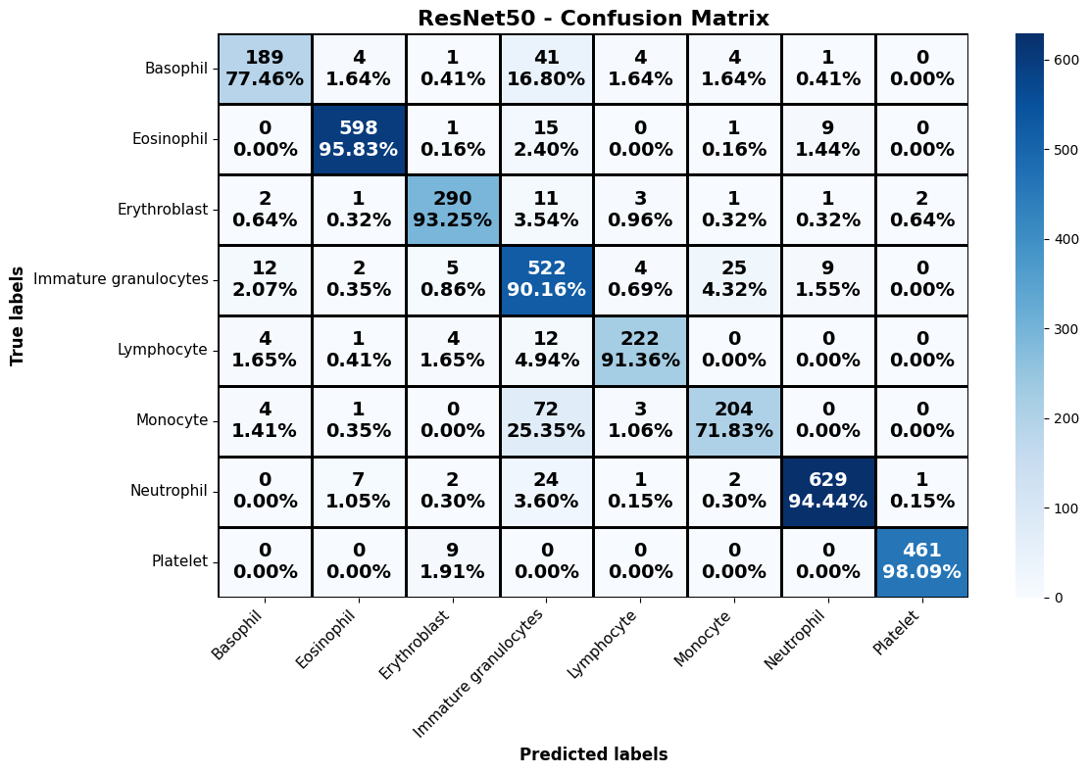
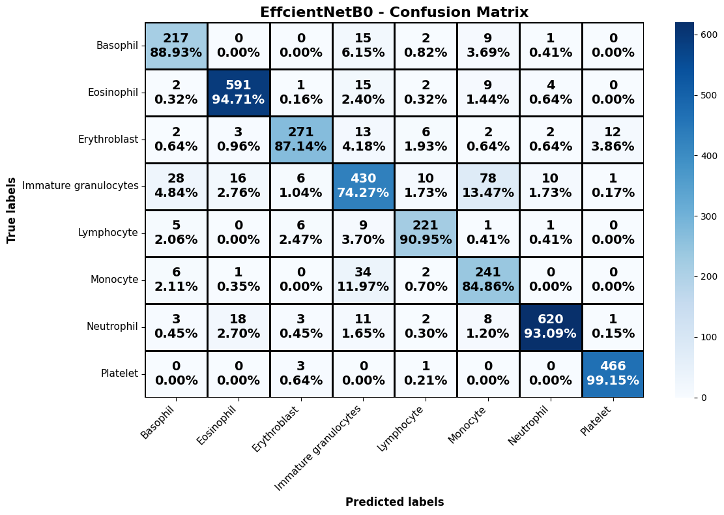

CNN Baseline Confusion Matrices
DenseNet121
ResNet50
EfficientNetB0
MobileNetV3Large

Slide 22
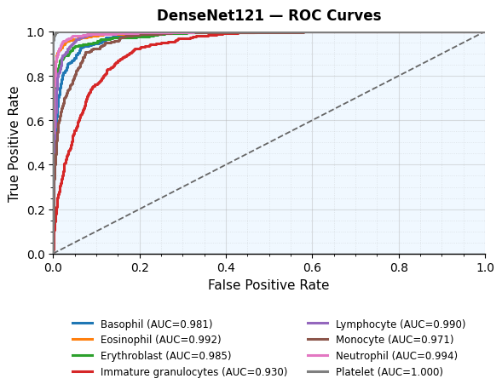
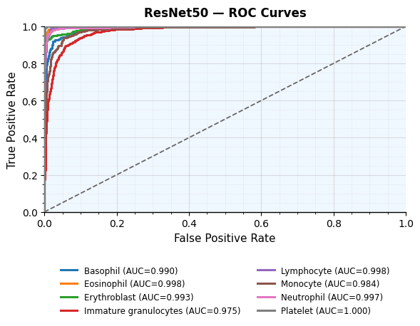
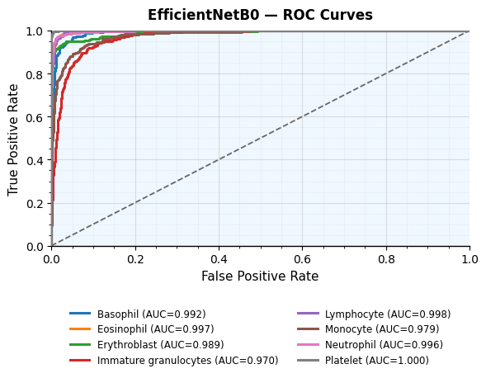

CNN Baseline ROC Curves
DenseNet121
ResNet50
EfficientNetB0
MobileNetV3Large

Slide 23
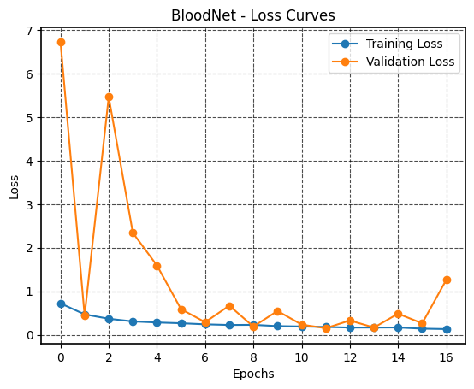
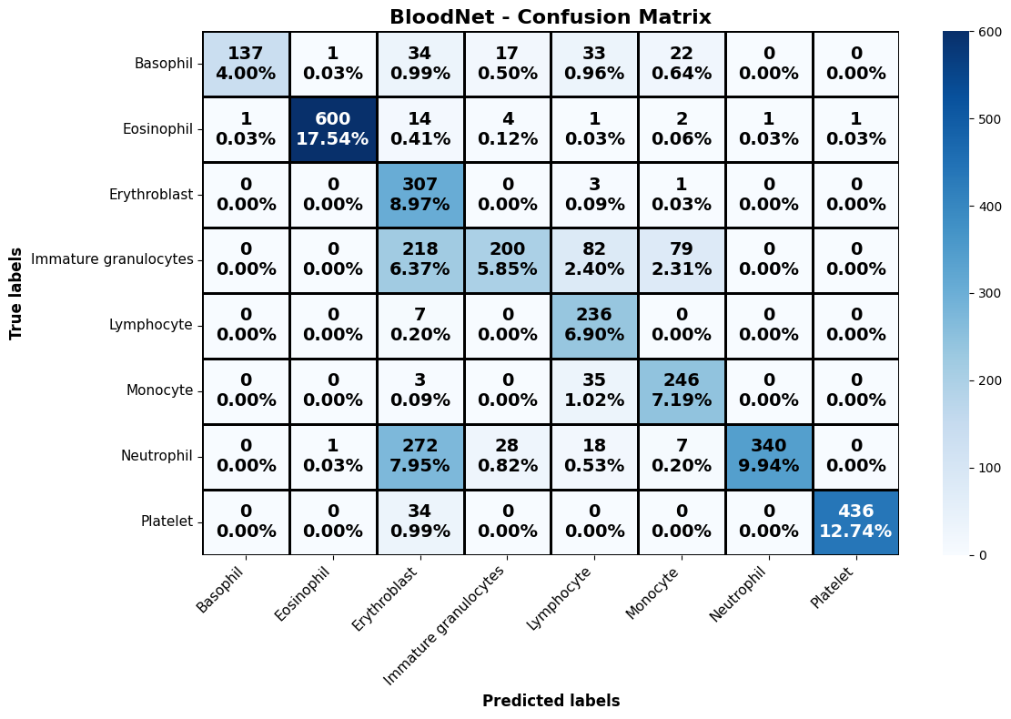
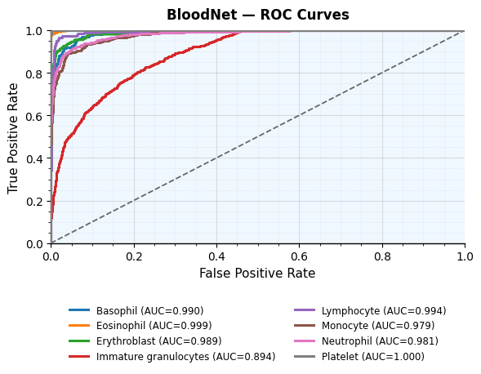
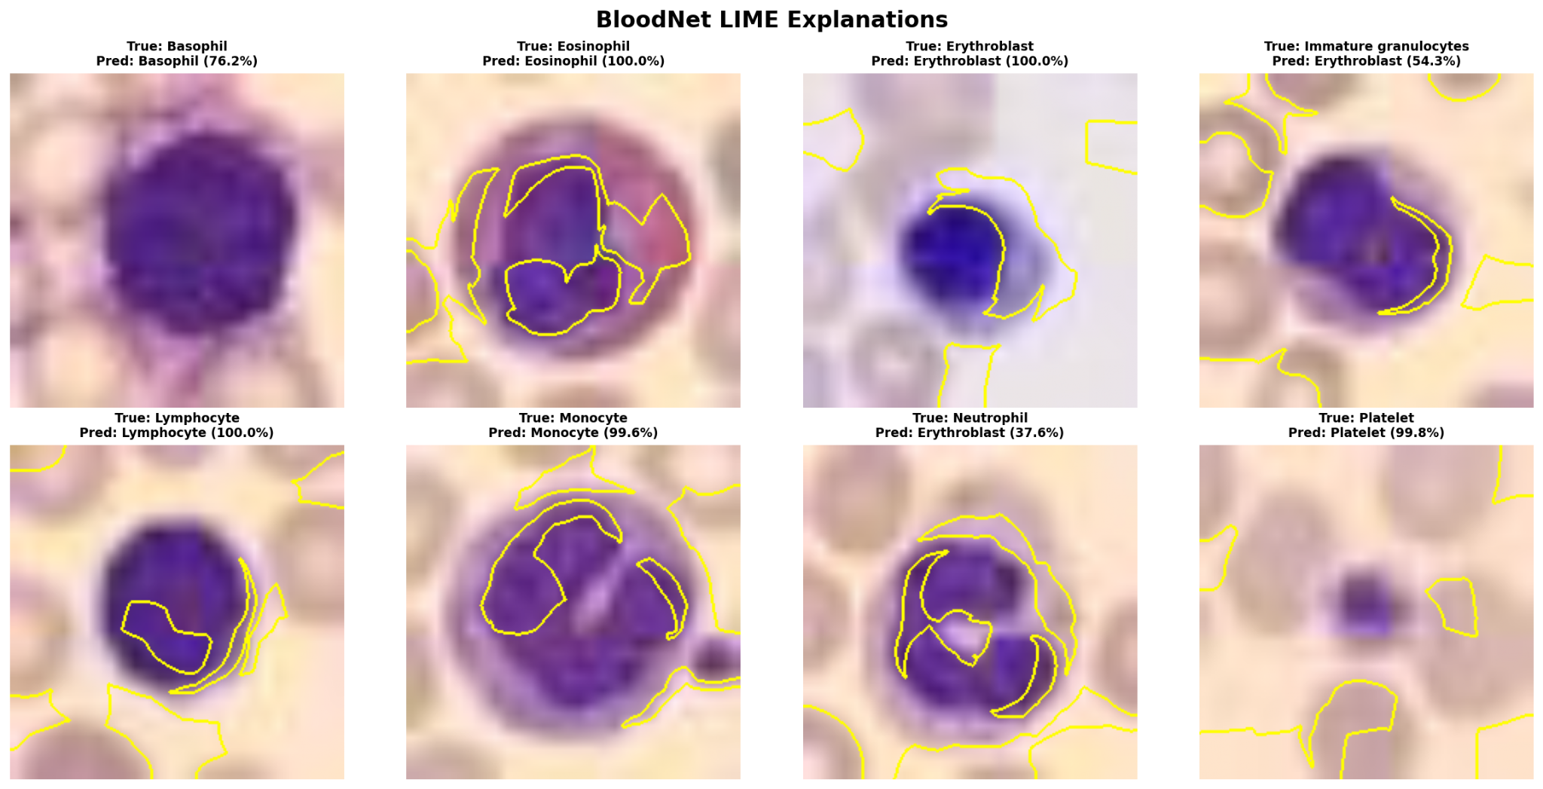
BloodNet Ablation: Loss, Confusion Matrix and ROC
Loss curve
Confusion matrix
ROC curves
LIME explanations

Slide 24
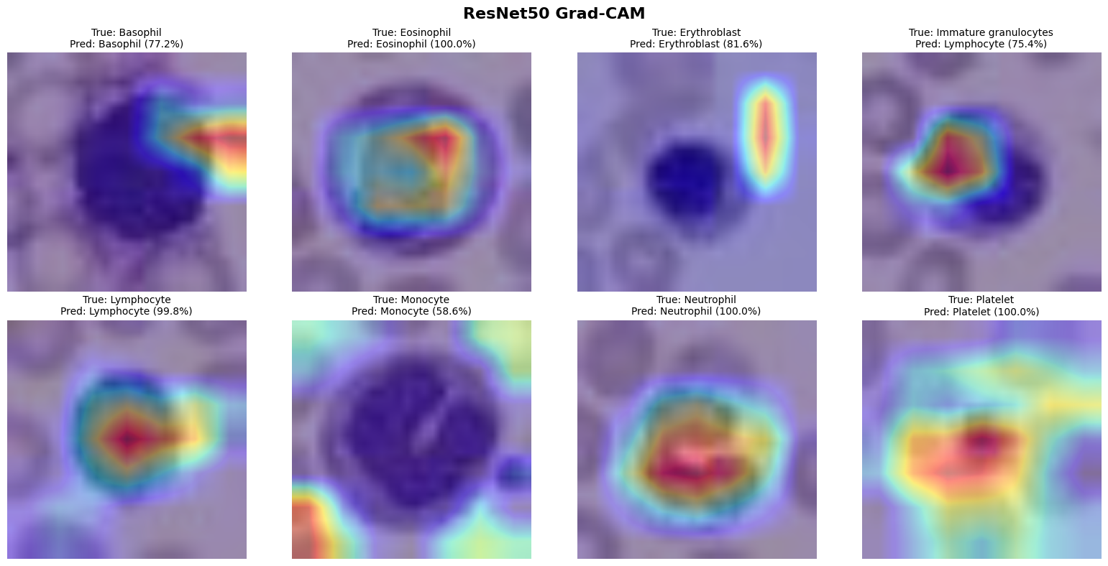
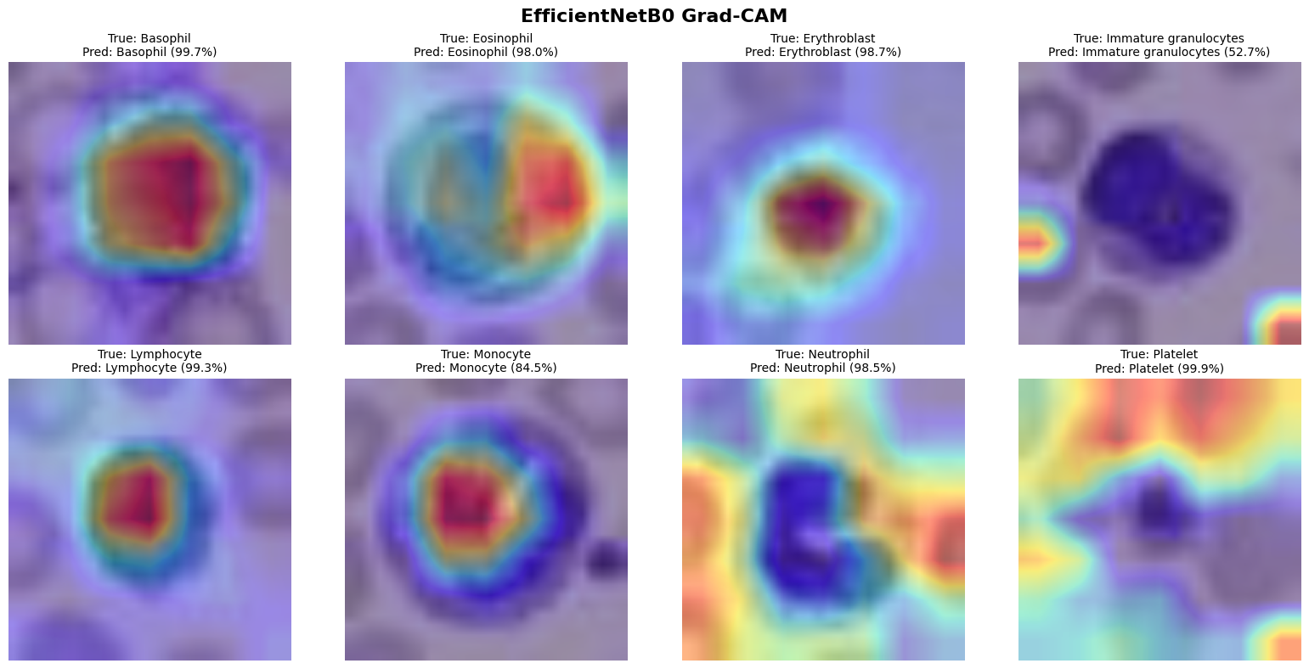
Explainability: ResNet50 and EfficientNetB0
ResNet50 Grad-CAM
EfficientNetB0 Grad-CAM

Slide 25
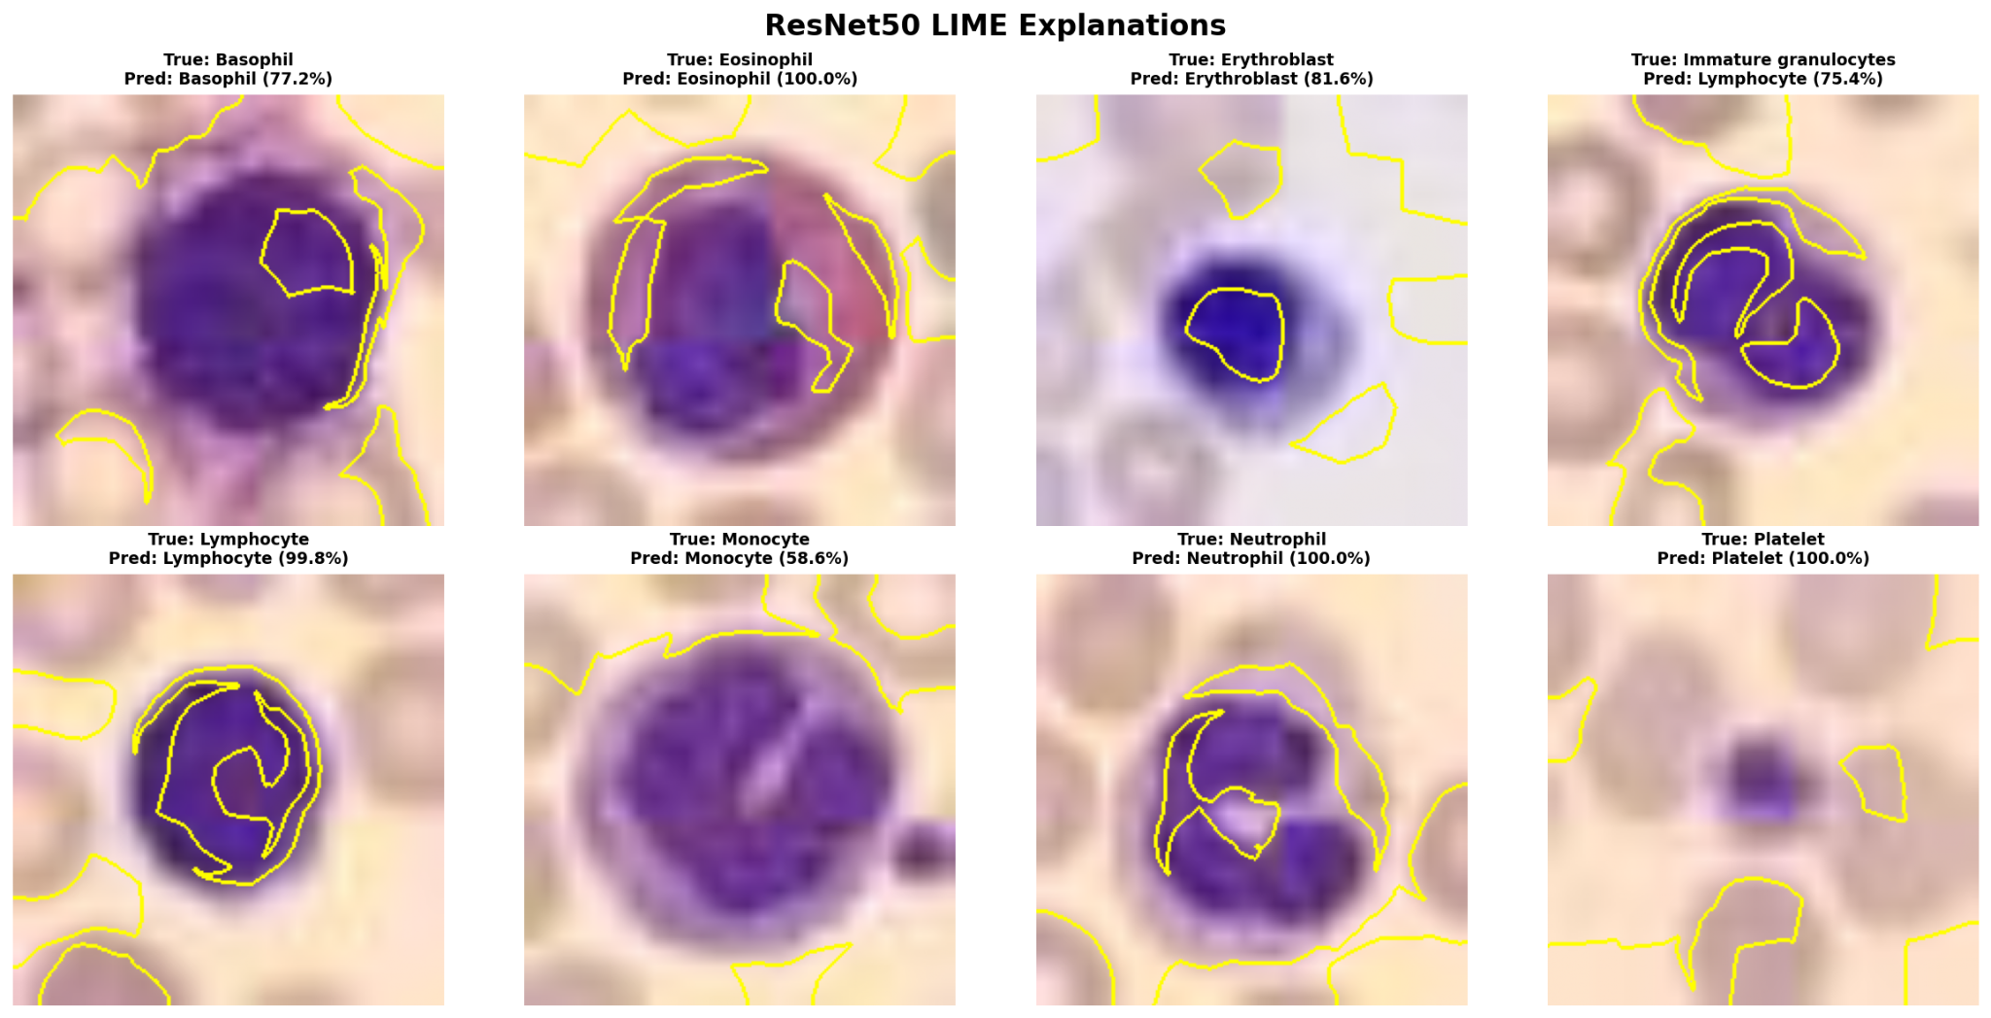
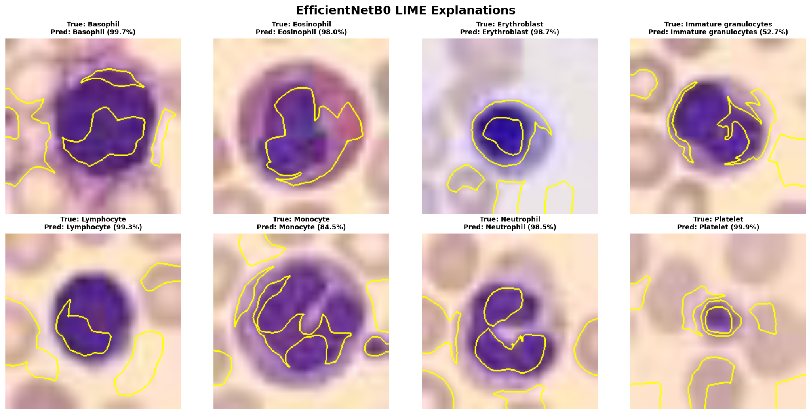
LIME Explainability: ResNet50 and EfficientNetB0
ResNet50 LIME
EfficientNetB0 LIME

Slide 26
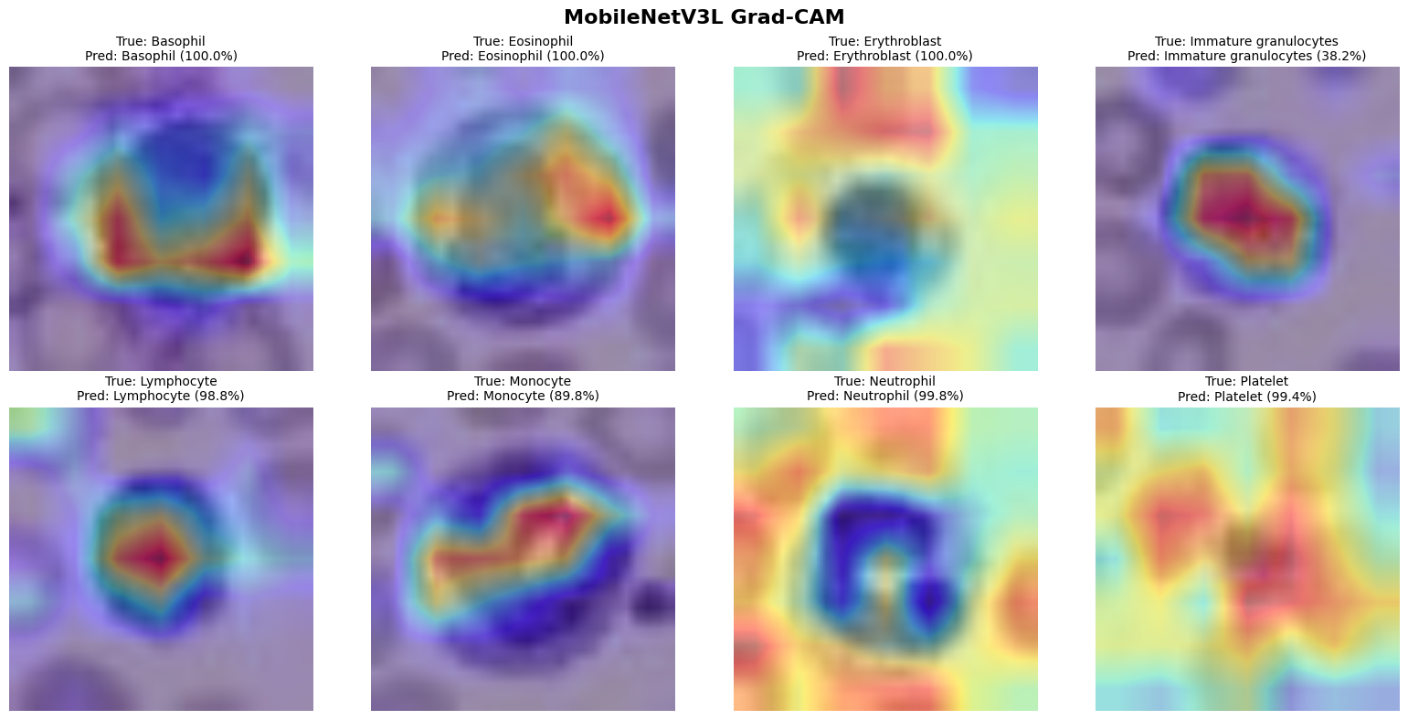
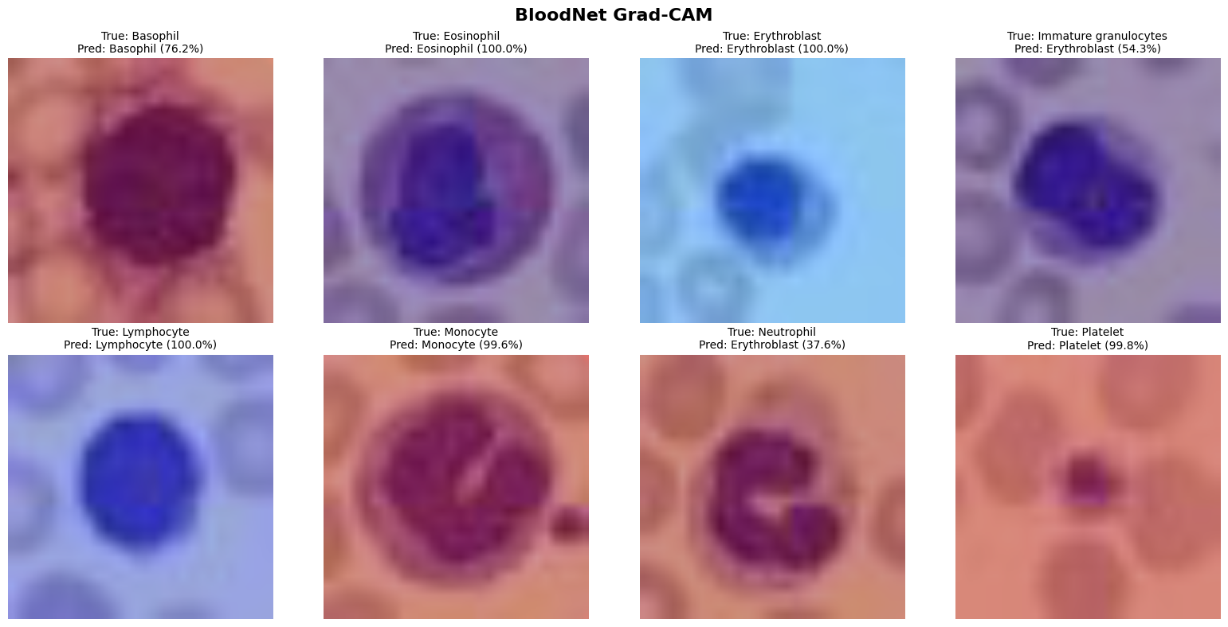
Explainability: MobileNetV3Large and BloodNet
MobileNetV3Large Grad-CAM
BloodNet Grad-CAM

Slide 27
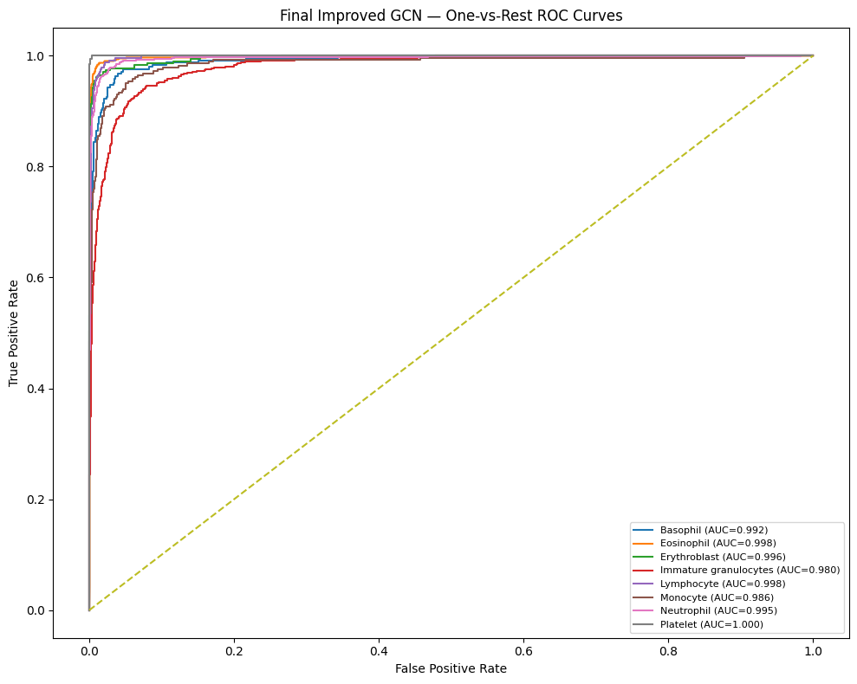
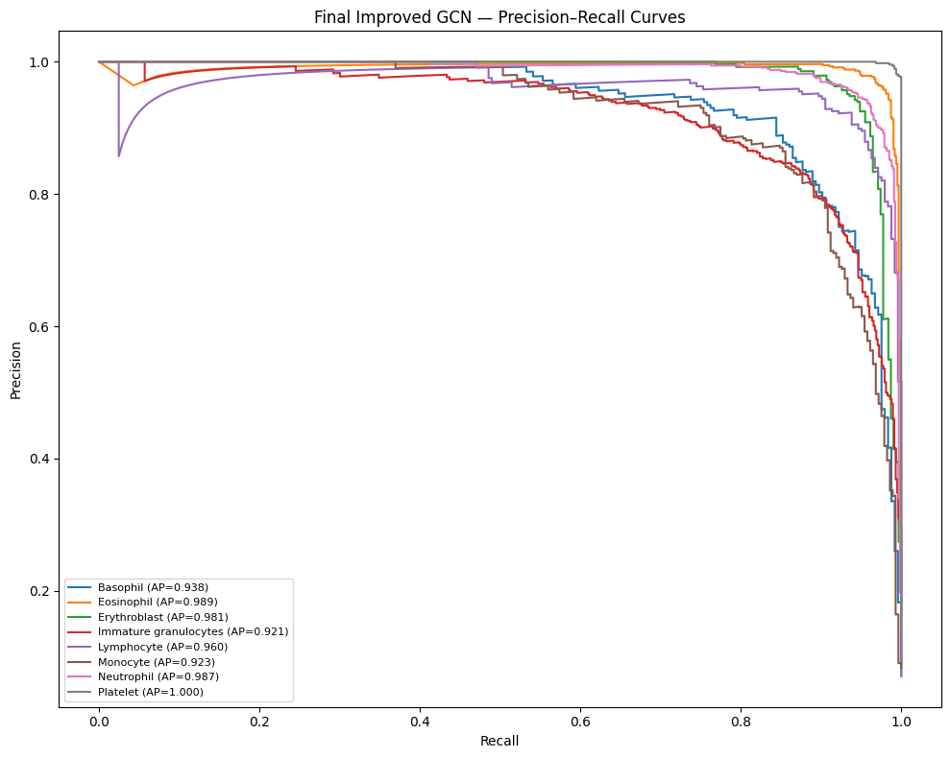
Final Residual GCN ROC and Precision–Recall Curves
One-vs-rest ROC curves
Precision–recall curves

Slide 28
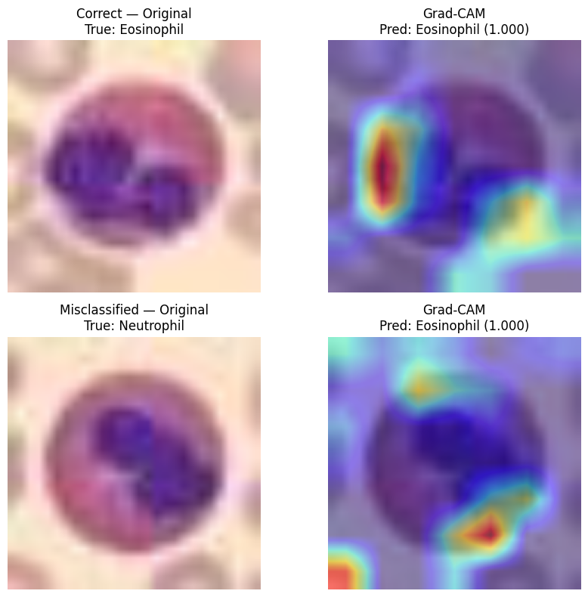

Final XAI Details: Grad-CAM and LIME
Grad-CAM on selected cases
LIME on selected cases

Slide 29

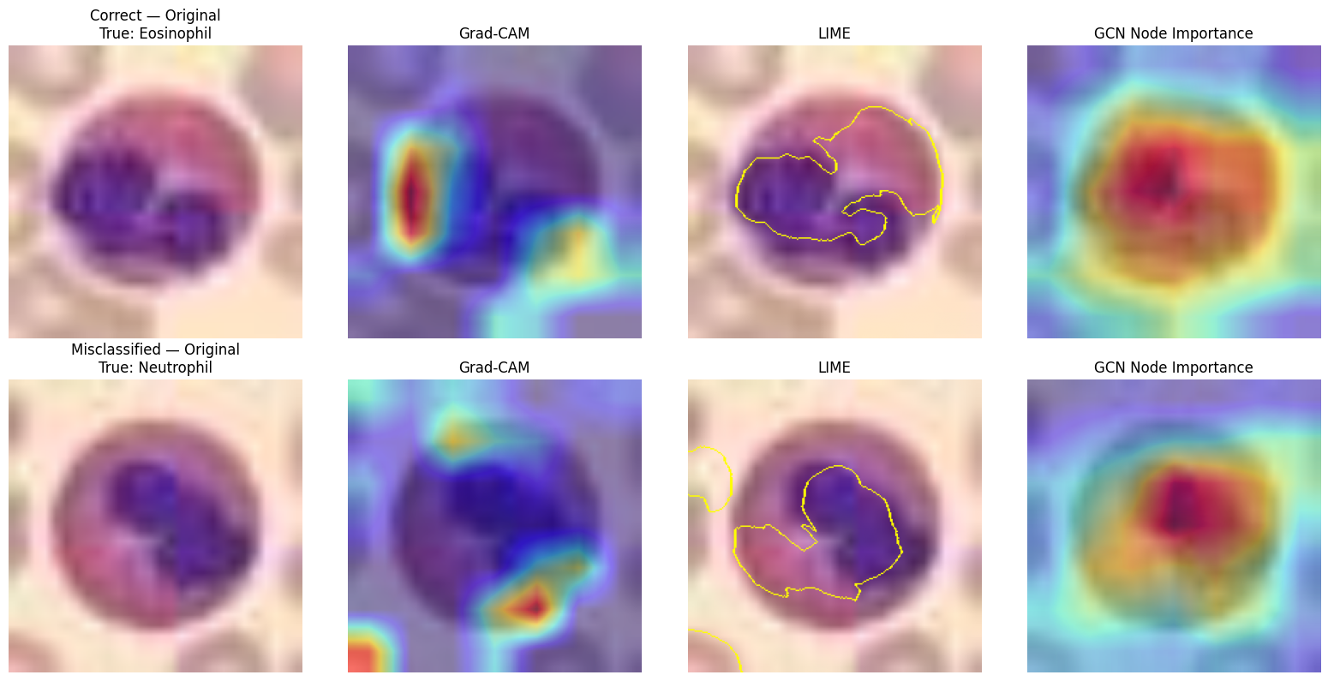
Final XAI Details: GCN Node Importance and Combined View
GCN node-importance maps
Original + Grad-CAM + LIME + node importance

Slide 30
Conclusion
Conclusion
› The final Residual GCN achieved 91.82% accuracy and 91.18% macro-F1.
› Graph reasoning gave a modest improvement over the strongest CNN baseline.
› Ablation showed that not every component improved the model.
› Best claim: the improvement is consistent, but not statistically significant at α = 0.05.
Limitations
› BloodMNIST images are only 28×28; resizing adds no new biological detail.
› Graph nodes are learned feature regions, not segmented cell parts.
› Only five paired folds were used for Wilcoxon testing.
› Future work can test stronger backbones and larger biomedical datasets.

